Slide 1
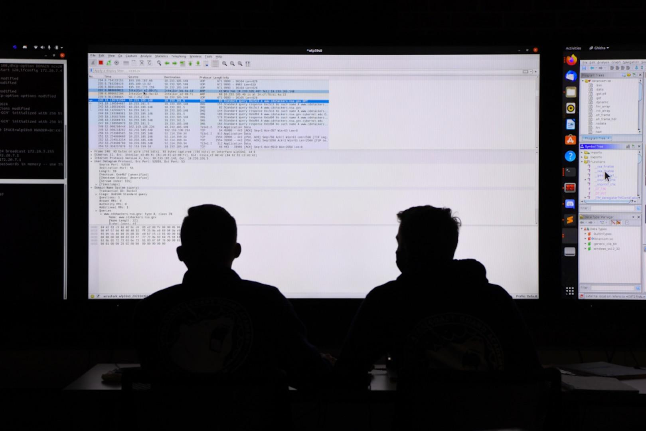
Cyber Challenge
Information Security

Slide 2

About the business:
Public power company
Usernames and passwords were just leaked from a credit union that works closely with ZAPP
Substation went offline and it is suspected that it happened internally
Suspected Credential Stuffing Attack

Slide 3
What do they want us to do?
Suspected Credential Stuffing attack:
Attacker used compromised password from credit union to see if any employees reused their password.
Used an employees VPN to enter the substations HMI and deny power downstream to customers
Tasks:
we must access Zapp Substation 434's internal network from a remote Windows workstation using a pre-configured VPN profile named Substation
Discover the compromised VPN account
Reset the compromised password to a more secure one
Bring the power back online.

Slide 4
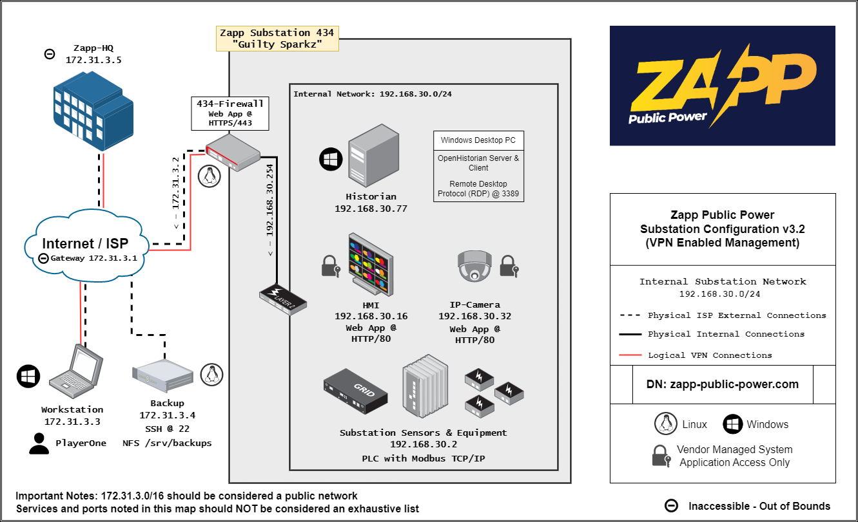
Network Architecture of Zapp Public Power
We were supplied with the network architecture of Zapp Public Power
We are player one in this instance and we are provided with the VPN credentials

Slide 5
Macro View of our thought process
Thought Process:
Where are we within the network when logging in?
Where would we find system login information?
What does a successful vpn connection look like?
Objectives:
Establish a concrete timeline
A way to view login information
Find a list of users who have access to the network
Team:
One person tackles GUI another CLI to parse logs, this way we can sort through quicker
Cross validate compromised user credential
Notes:
Thought process under pressure

Slide 6
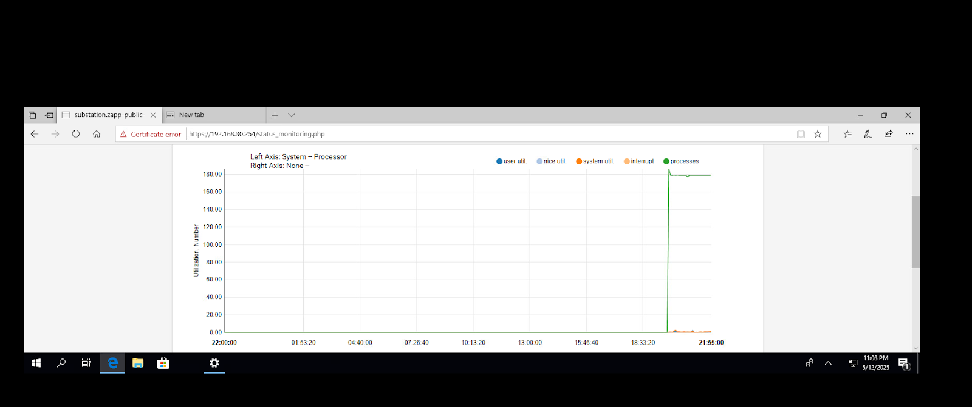
Status monitoring interface

Slide 7
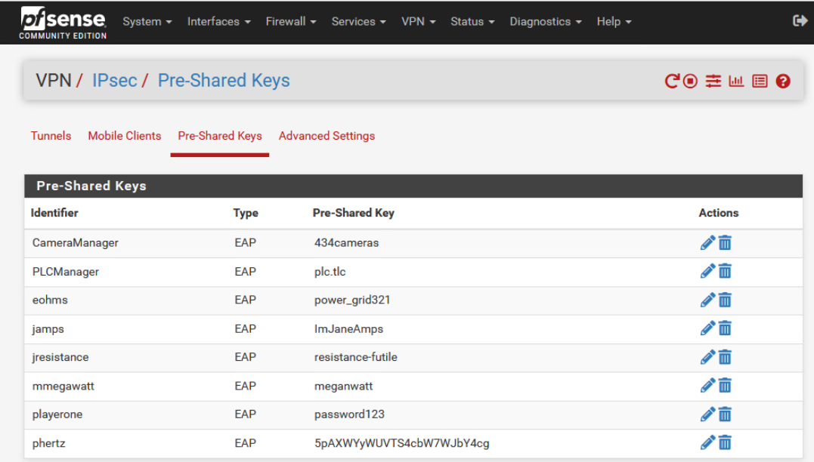
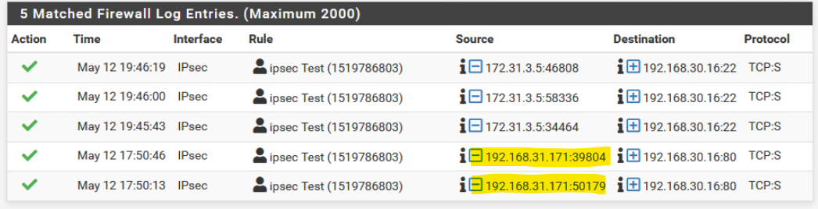
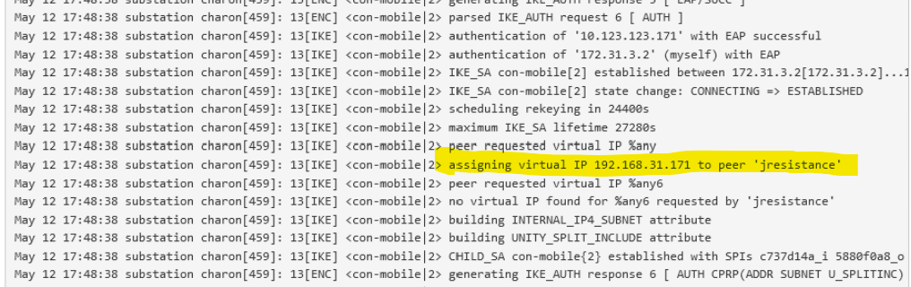
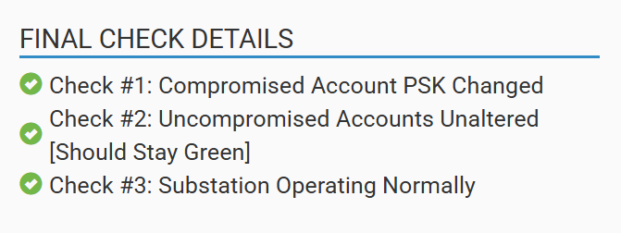
Challenges Solved
Found preshared keys and what looked like usernames
Navigated to firewall logs and filtered the content to display connections targeting the known HMI system at IP address 192.168.30.16.
We identified a suspicious internal IP address of 192.168.31.171.
Under IPSec Logs around the time when we determined the system went down we noticed a log that had one of the usernames listed on the preshared keys list assigned that same IP address.
As a team we determined this was the compromised account.

Slide 8
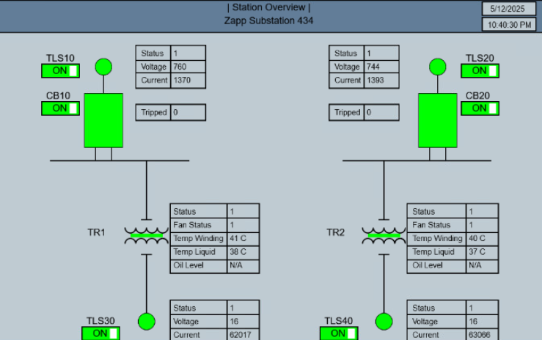
Challenges solved (cont.)
Navigated to HMI Interface via ip 192.168.30.16 and toggled TLS10 and TLS20 ON
Restored the service.

Slide 9
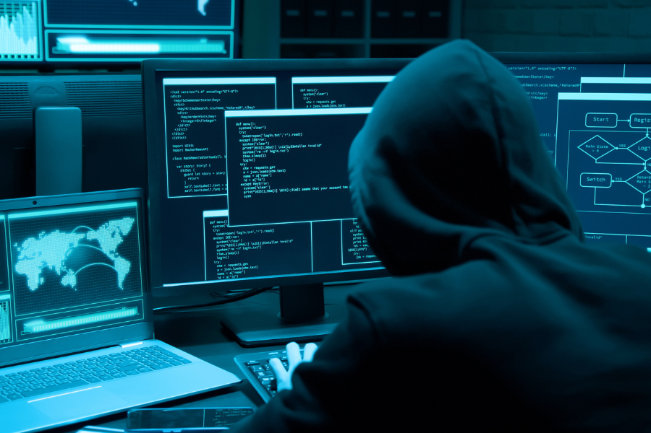
Tools Utilized and Purposes
VPN Client
Establish secure remote access to substation 434’s internal network
Firewall Web Interface
Access VPN authentication logs and manage user accounts
HMI Client/Web Interface
Control substation equipment, restore power by reconfiguring physical switches

Slide 10
What could we have done differently?
It would have been far more efficient to parse logs on our own machine rather than within the VM
Clearer understanding of log retention in pfSense
Allocating actionable objectives to team
Clearer role assignment

